Slide 1
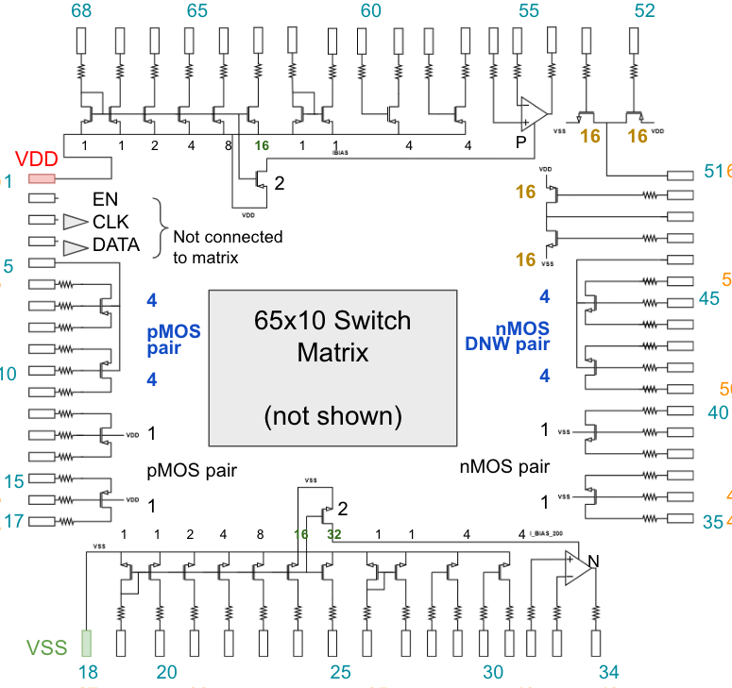

Slide 2
nMOS pair
nMOS Current Mirror

Slide 3
nMOS pair
nMOS Current Mirror

Slide 4
pMOS Current Mirror
pMOS
one-stage OTA
4x CS nMOS

